Slide 1
Caleb’s Journey in America

Slide 2
Overview
Who am I? What do I do?
What was my UNLV experience like?
How did I end up with my current job?
What can you do to get a better chance in tech?
Questions and Answers

Slide 3
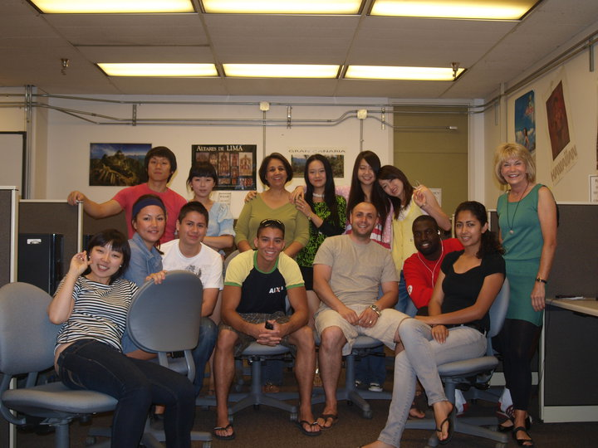
ELC Class - 2010

Slide 4
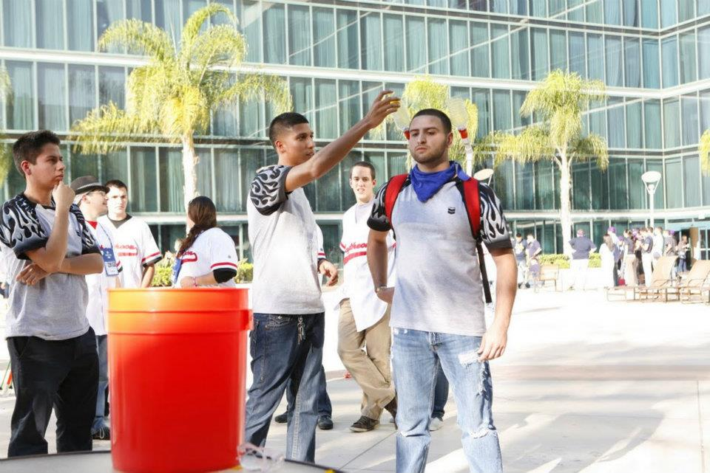
Extreme Engineering Challenge - 2011 Team Chevron - Anaheim, CA

Slide 5
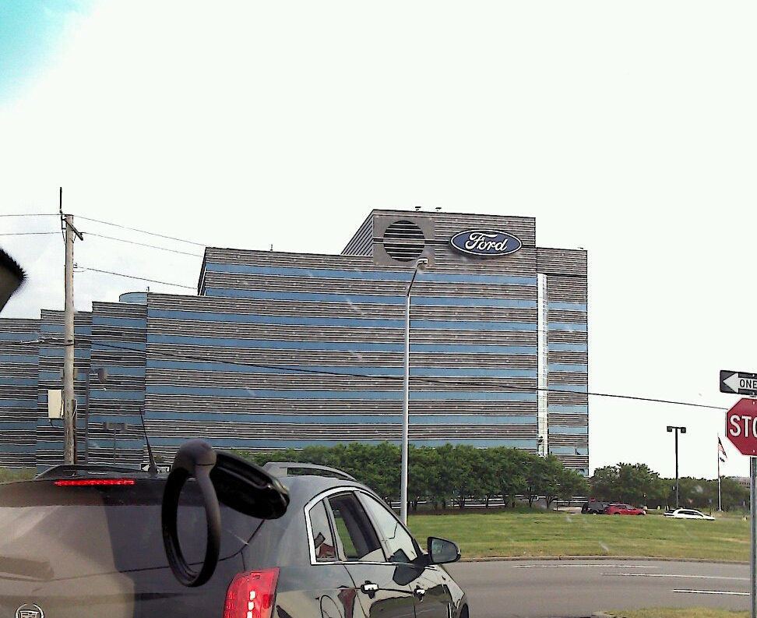
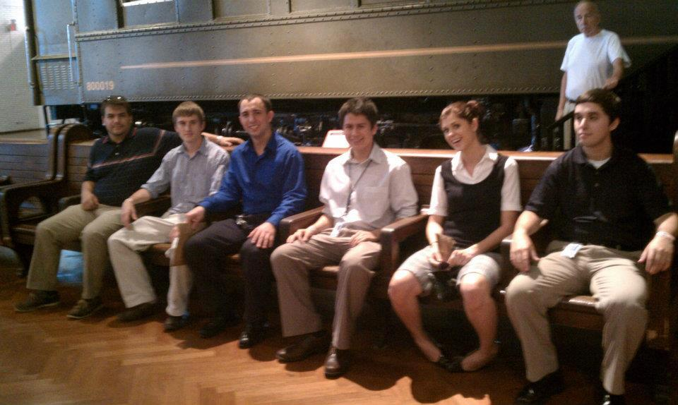
Ford Motor Company - 2012 Dearborn, MI

Slide 6
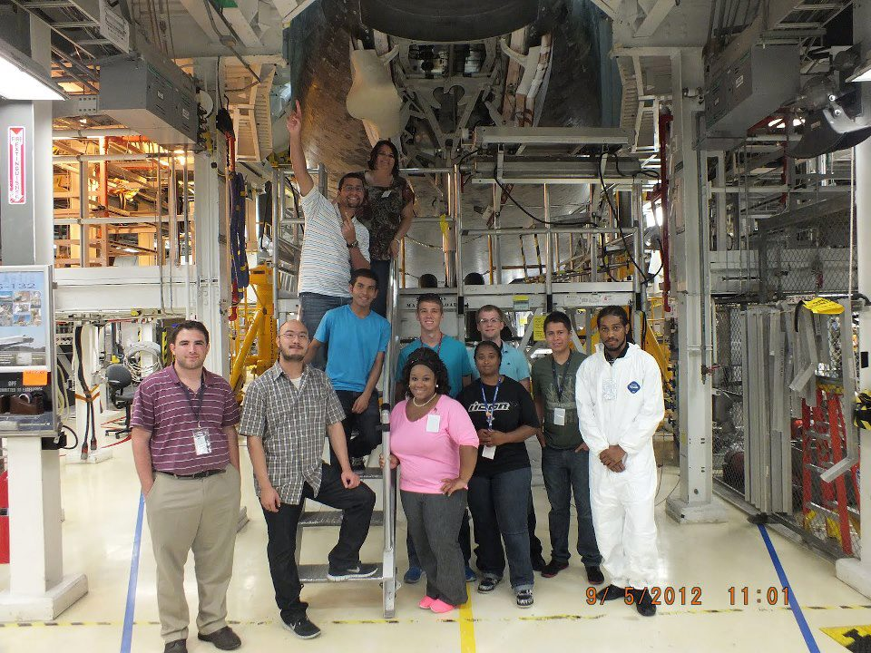
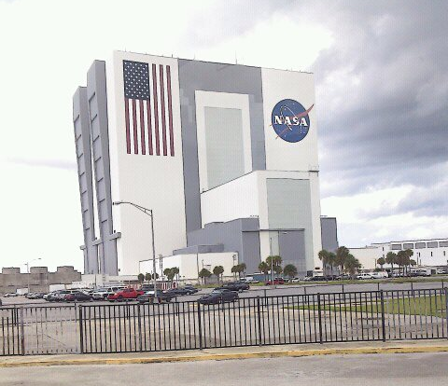
NASA – 2012 Cape Canaveral, FL

Slide 7
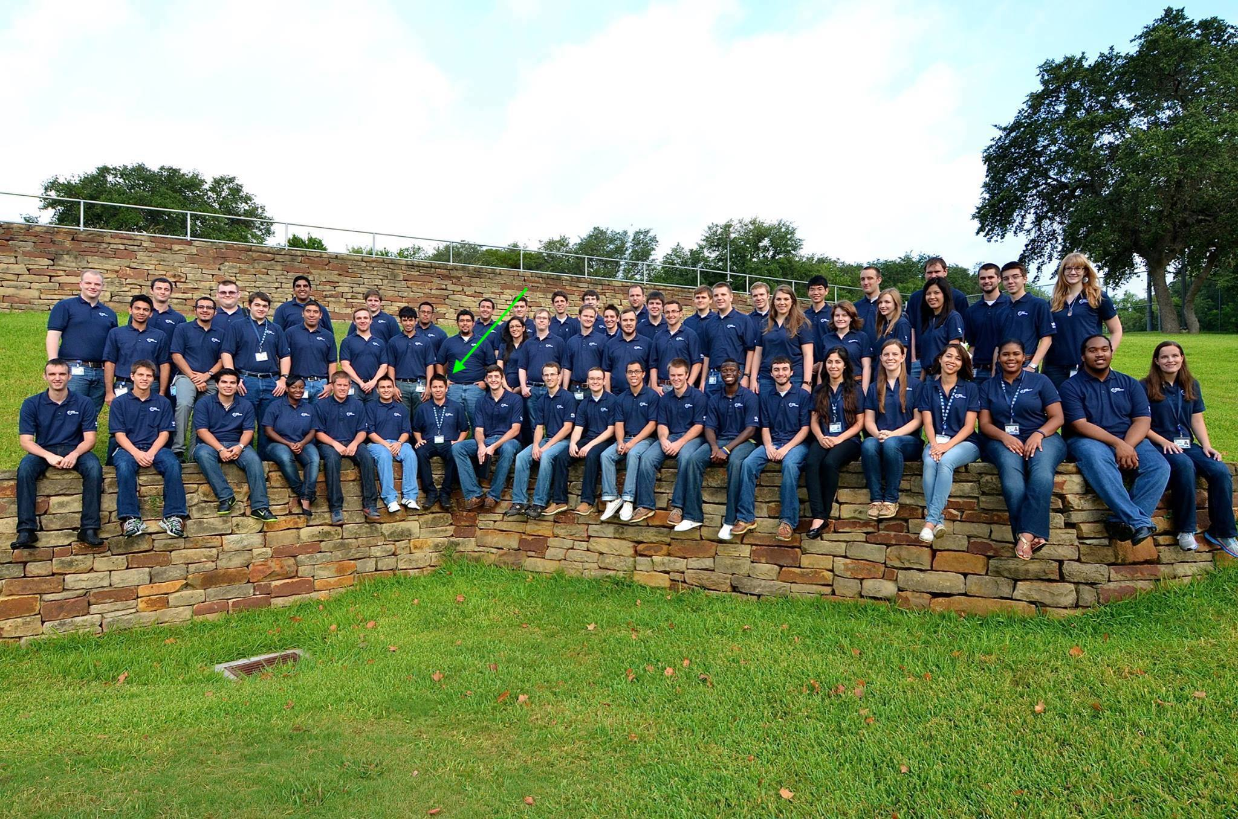
USAA – 2013 San Antonio, TX

Slide 8

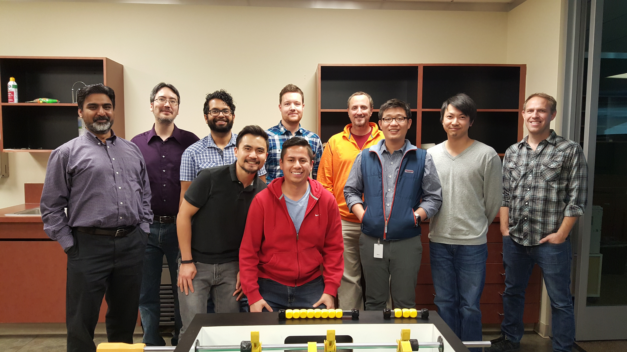
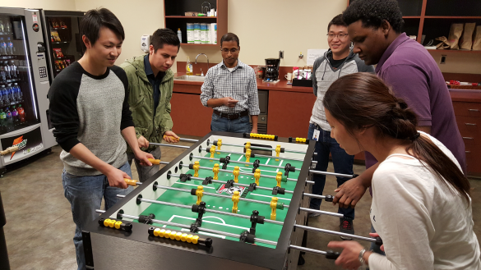
IBM – 2015 Las Vegas, NV

Slide 9

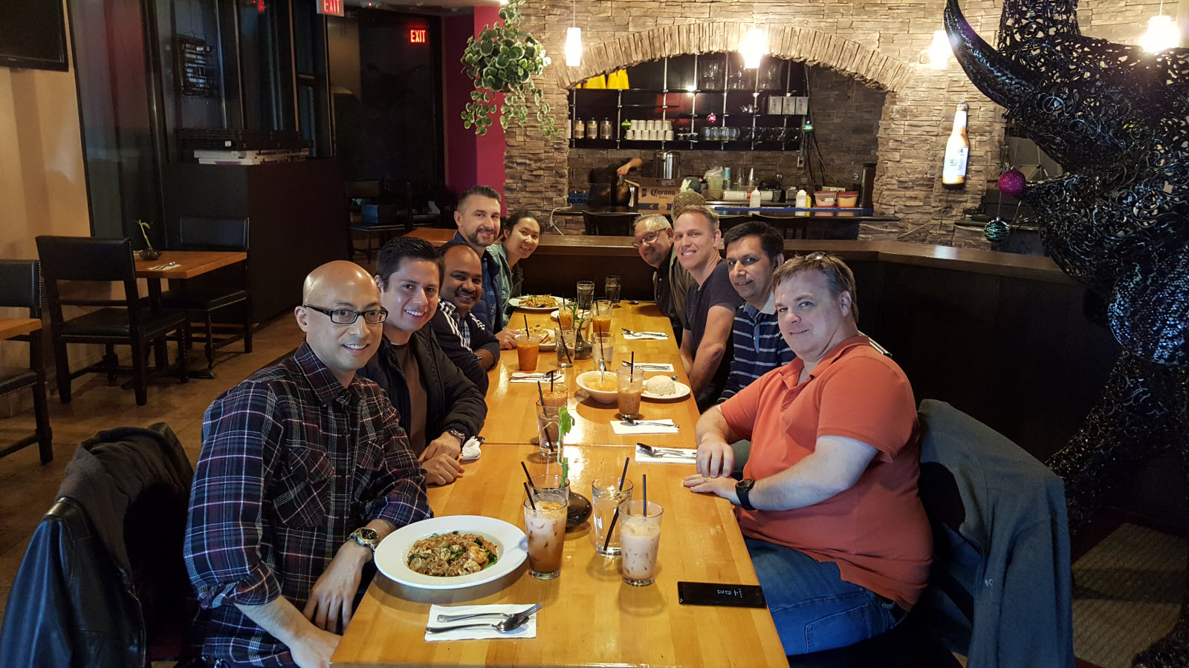
Wipro 2017 Las Vegas, NV

Slide 10
My suggestions
Master the basics of your career.
Practice interviewing, communication and people skills.
Build and maintain a solid social network.
Do something you truly enjoy outside of the classroom.
Anything is possible, be patient and always seek goodness for the other people.

Slide 11

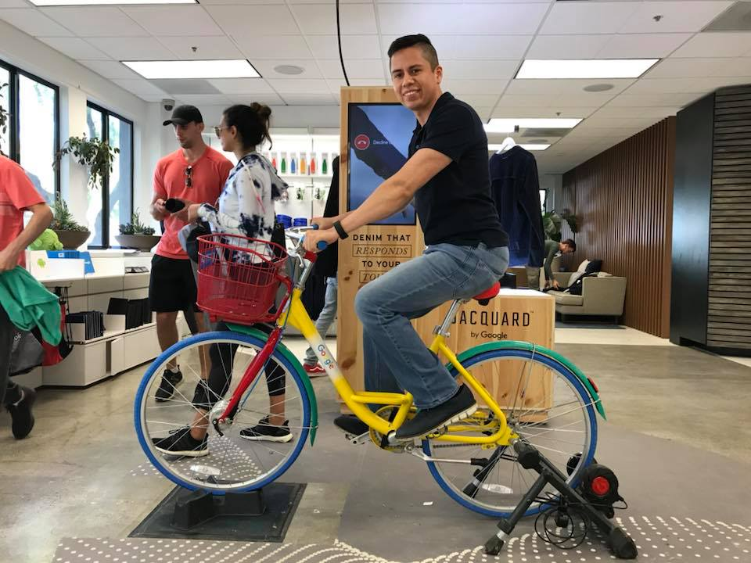



Questions and Answers

